Slide 1
Revolute Fitness Gym / Fitness App
Kevin Quinn / C00216607 / 17th of January 2020.
Notes:
Hi everyone, my name is Kevin and today I will be discussing with you my final year project which Ive named Revolute Fitness, a gym and fitness app.

Slide 2
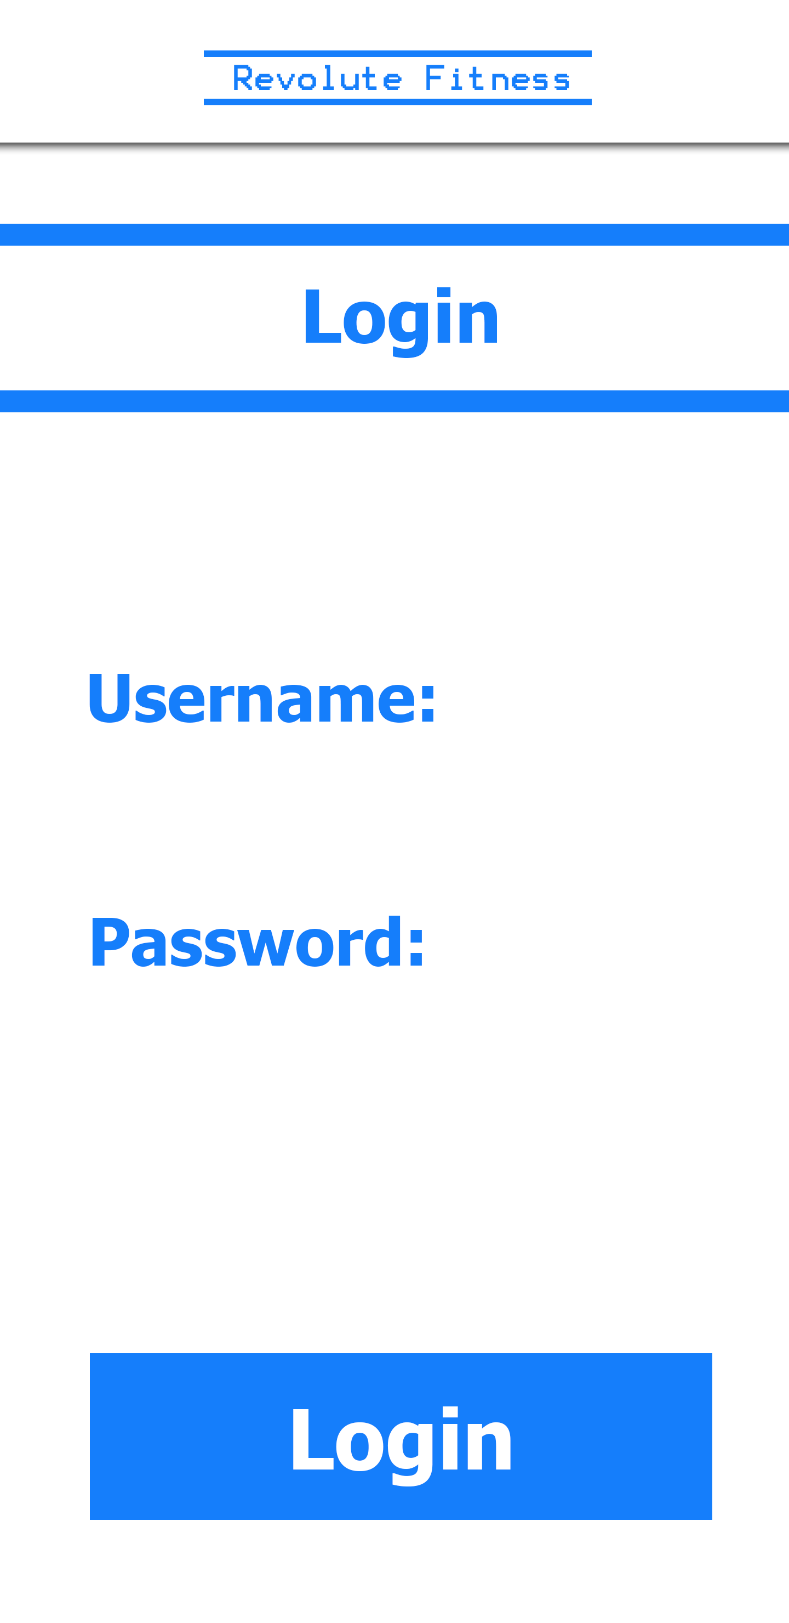
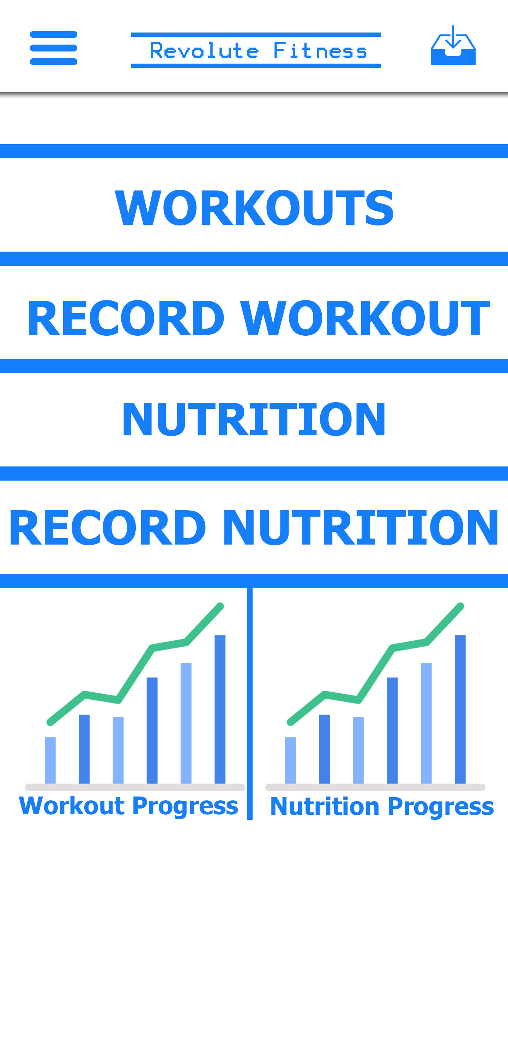
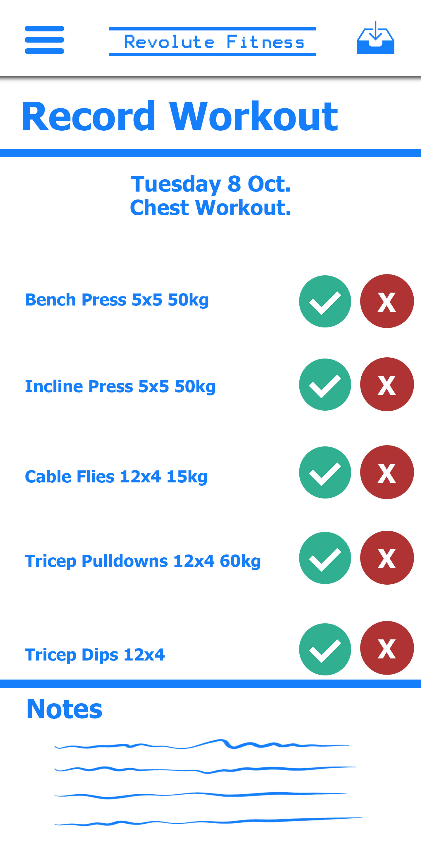
Project Description
Gym and fitness app targeted at Personal Trainers (PT) and Clients.
Allow PT to manage their clients fitness regime easily.
Implementation of machine learning to analyse exercise form.
Notes:
The idea of the project is to create a Gym app which is targeted at Personal Trainers and their clients, as well as the average gym user. The app will give the PT a centralized location in which to manage everything to do with their clients including their workout and nutritional plans. With this the client will be able to record their workout and the PT can analyse their progress. The what I believe to be the stand out feature I want to try implement is a Exercise Form Analysis which will be able to inform the user to weather they are using correct form when completing an exercise using a phot or video. Currently the market is oversaturated with fitness apps which allow a user to record there workouts, but the nieche of this project is how it will allow PTs to work and the Form Analysis.

Slide 3
Work Completed
Research Document.
Functional Specification.
Design Manual.
Initial app structure using Xamarin.
Semi-functional login screen.
Implementation of REST API for future development.
Basic navigation structure.
Notes:
So currently with this project I have completed the Research Document, Functional spec and design manual but these will need to be revised towards the end of the project. I have also developed a semi functional login system on the app using Xamarin forms, and also the implementation of the REST API to communicate with the backend server. Ive also developed a basic navigation structure for the app.

Slide 4
Work Still To Be Done
Finish out login and registration system.
Finish out user experience, which includes.
Creation of workout plans
Being able to record workouts
PT’s being able to manage clients experience
Exercise Form Analysis.
Notes:
With my work still to be done, I still need to completely finish out the login / registration system aswell as the actual user experience which includes being able to create workouts record workout PT’s being able to manage their clients and the implementation of the Exercise Form Analysis feature.

Slide 5
Technology Options / Discussion
Development in Xamarin steep learning curve, lack of experience.
Using Xamarin has led to a great amount of time being spent on trying to learn and understand a completely new technology.
Might be able to achieve functionality I've developed so far in a different framework in a fraction of time already spent.
Notes:
With my technologies I don’t think Xamarin was a good technology to use, it is a steep learning curve and I lack experience with its kind of development. Using Xamarin has led to me spending lots of time trying to learn this new technology and understand it, which I think would be better spent actually developing. I feel that if I was to use a different framework such as Ionic where I could use technologies such as html css js and php that I am familiar with and have decent experience with I could have achieved what I have so far with Xamarin in a fraction of the time.

Slide 6
Potential Issues / Challenges
The implementation of machine learning will be very tough but I find it interesting.
I find it difficult to focus and work efficiently on a project when I have to constantly jump between 2 or 3.
But I am confident I will finish :D.
Notes:
One thing I am looking forward to is the implementation of machine learning into my project as I find it intresting but this will be tough. I also find it tough to focus and work effiecently on this project because of the need to jump between many other projects also but this all just comes down to effective time management. All in all I am confident I will finish out my project and be happy with what I create

Slide 7
Thanks For Listening Any Questions !
Kevin Quinn / C00216607 / 17th of January 2020.
Notes:
That’s my presentation, thanks for listening any question ?

